Slide 1

Operation Analytics and Investigating Metric Spike
SUBMITTED BY: RASHMI WARIYAL
SUBMITTED TO:TRAINITY

Slide 2
PROJECT DESCRIPTION
The project consists of 2 case studies:-
First is regarding Operational Analytics where job data is provided and number of job reviewed, 7 day rolling average of throughput, percentage share of language used and duplicates are found.
The second is Investigating Metric Spikes where user engagement, user growth, weekly retention, weekly engagement and email engagement is determined.
The following information is found with the help of SQL queries.

Slide 3
APPROACH
I got the information from the description and the data given and I understood the problem.
Gone through the raw data and understood the data and attributes as given.
Used My SQL Workbench and imported the csv files into new databases named as ops_analysis and metric_spike.
I started to write my queries based on the task given.
Then I executed the queries to obtain the meaningful insights.
Once done with all the queries I cross checked them and saved into file.

Slide 4
TECH-STACK USED
My SQL version 8.0 was uses in this project.
My SQL Workbench was used to write and execute the queries.
After collecting all the required insights, Microsoft Powerpoint was used to present the project.

Slide 5
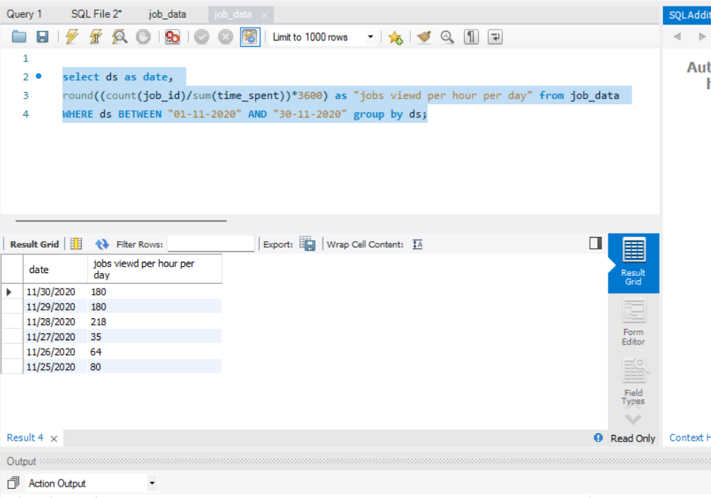
INSIGHTS AND RESULTS CASE STUDY 1:-
A.JOBS REVIEWED OVER TIME
Objective: Calculate the number of jobs reviewed per hour for each day in November 2020.

Slide 6
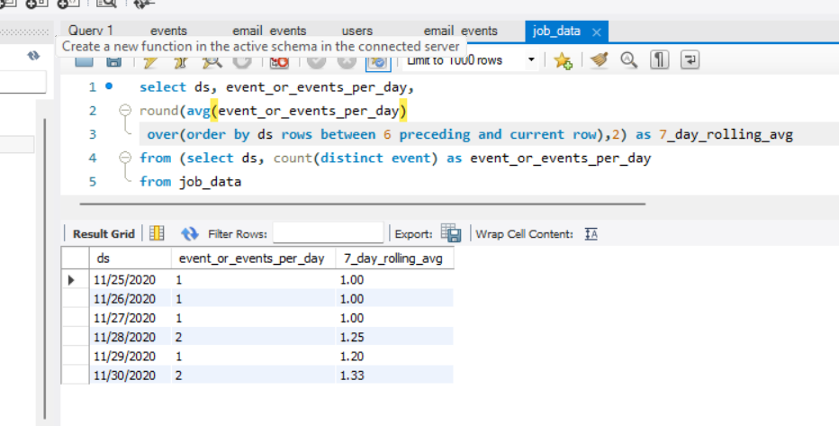
B. Throughput Analysis:-
Objective: Calculate the 7-day rolling average of throughput (number of events per second).

Slide 7
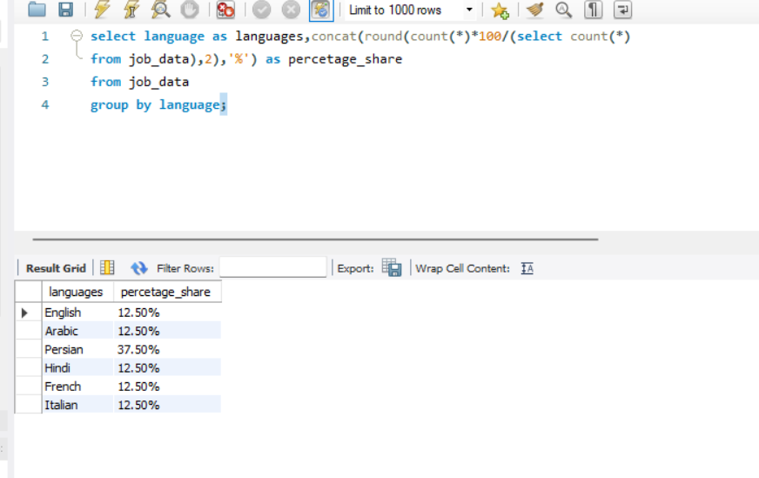
C. LANGUAGE SHARE ANALYSIS
Objective: Calculate the percentage share of each language in the last 30 days.

Slide 8
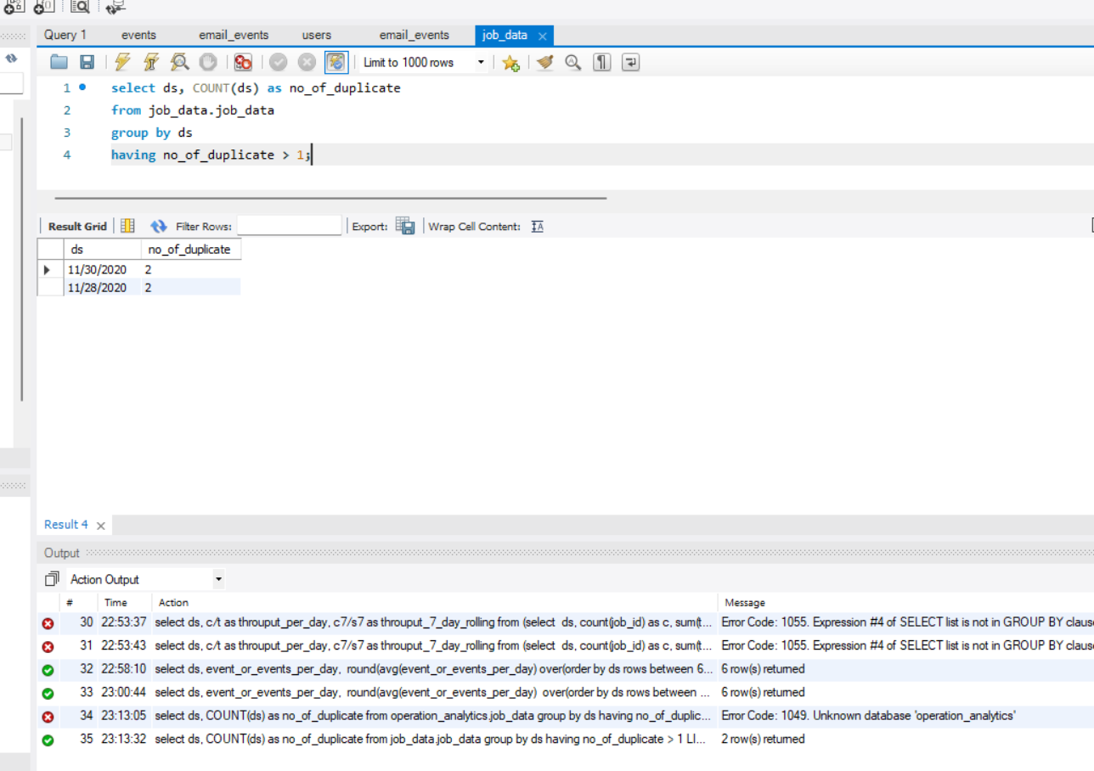
D. DUPLICATE ROWS DETECTION
Objective: Identify duplicate rows in the data.

Slide 9
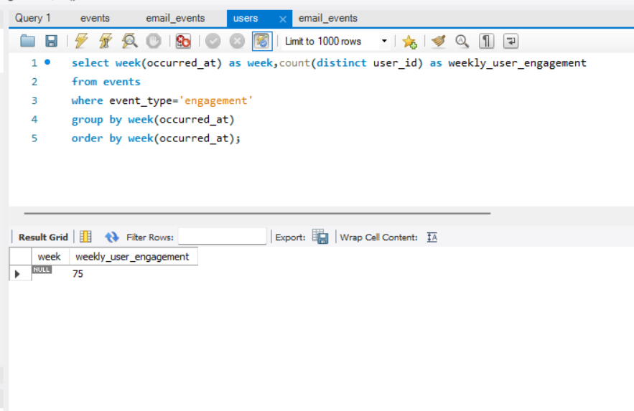
INSIGHTS CASE STUDY 2:-
A.WEEKLY USER ENGAGEMENT
Objective: Measure the activeness of users on a weekly basis.

Slide 10
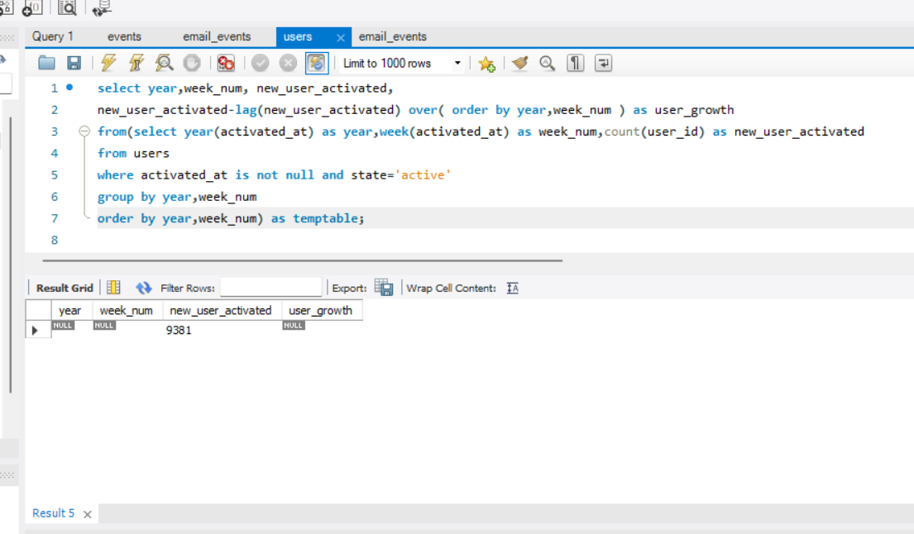
B. USER GROWTH ANALYSIS
Objective: Analyze the growth of users over time for a product.

Slide 11
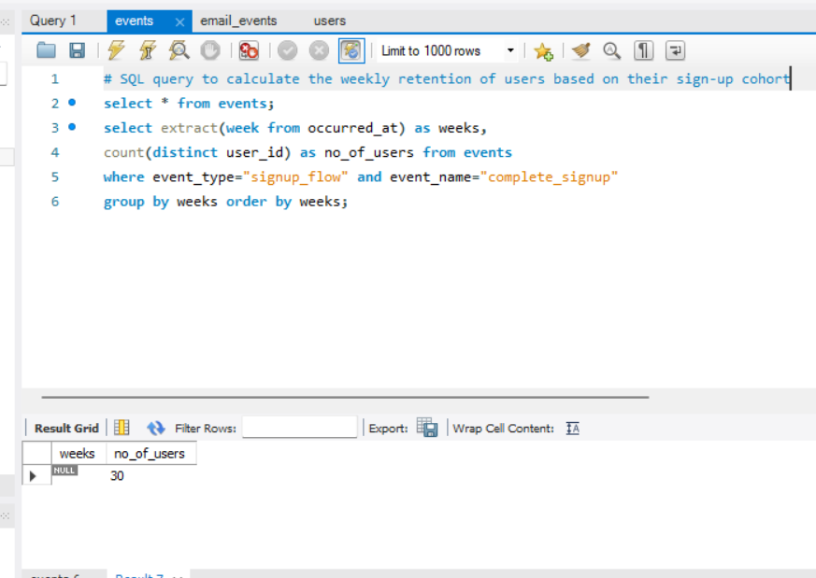
C. WEEKLY RETENTION ANALYSIS
Objective: Analyze the retention of users on a weekly basis

Slide 12
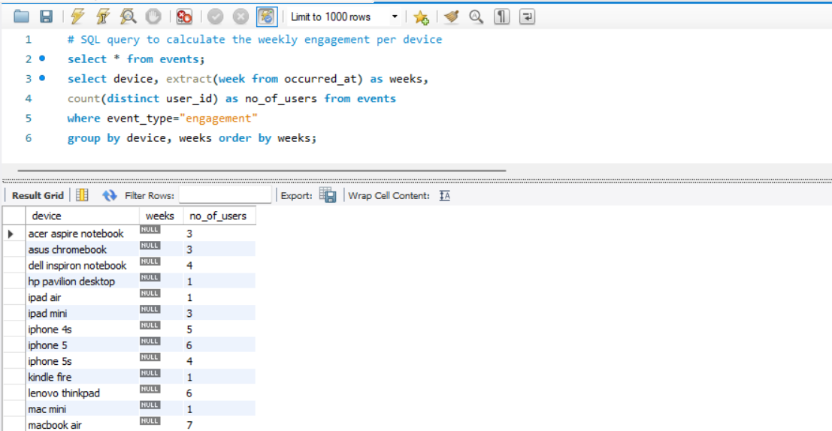
D. WEEKLY ENGAGEMENT PER DEVICE
Objective: Measure the activeness of users on a weekly basis per device.

Slide 13
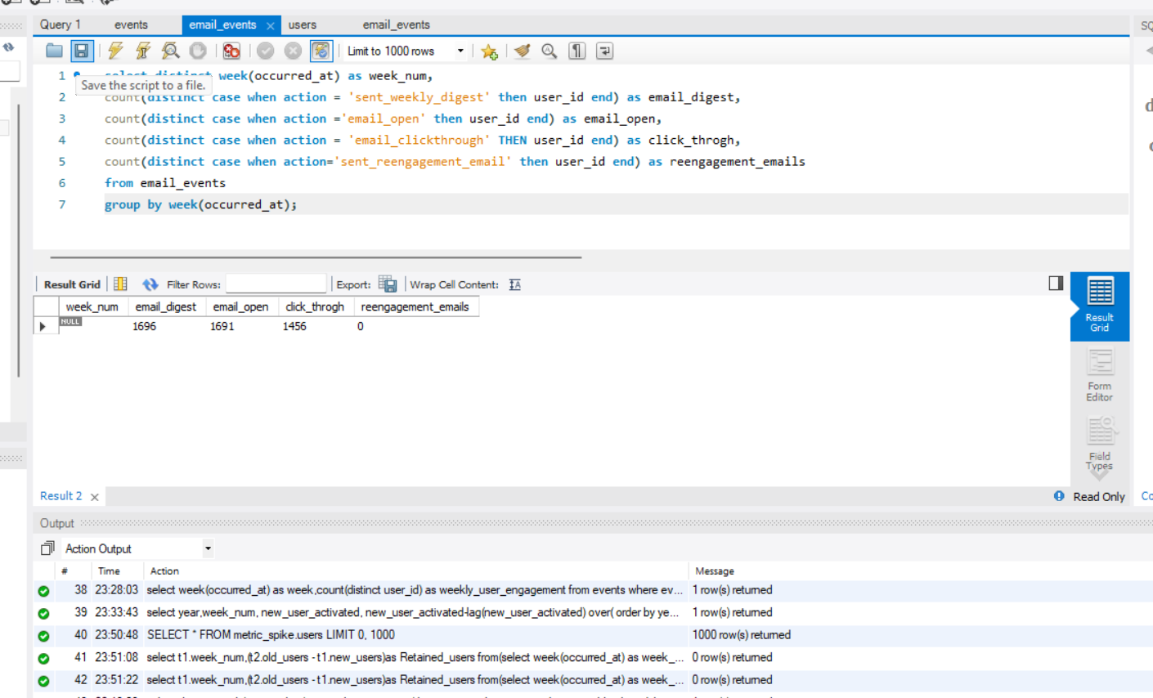
E. EMAL ENGAGEMENT ANALYSIS
Objective: Analyze how users are engaging with the email service.

Slide 14
THANK YOU

